Slide 1


2023 Christmas & Holiday Party
December 6, 2023

Slide 2
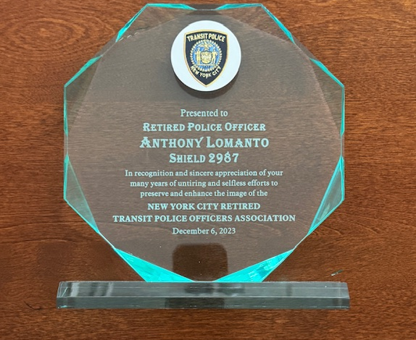
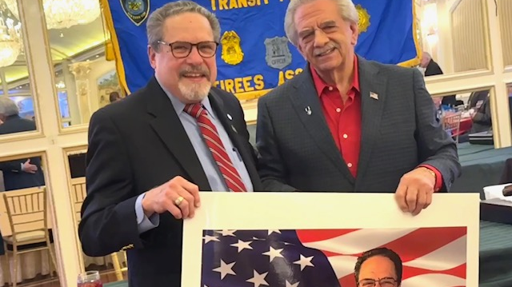
Award plaque from the Transit Police Retirees Association
President Valentino presenting Treasurer Tony Lomanto a caricature poster designed by Ron Morales with an assist by Lou Hollander

Slide 3
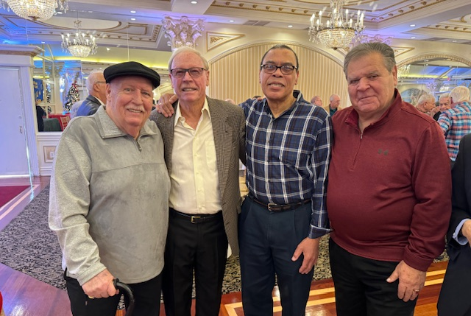
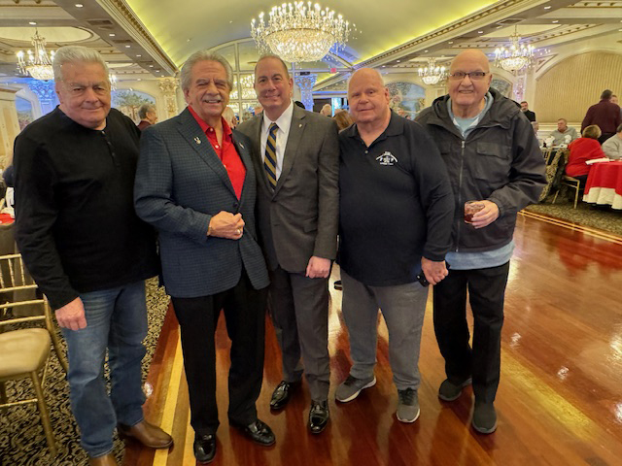
L- Mike Lanning, Bob Kent, Henry Smith, Deo Fasolino
R- Luke Scarangello, Bob Valentino, Paul DiGiacomo, Hank Melchiona, Frank Crisa

Slide 4
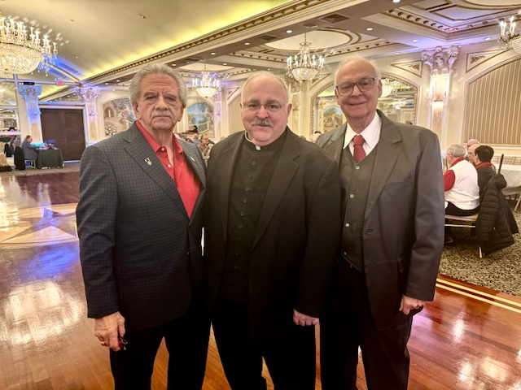
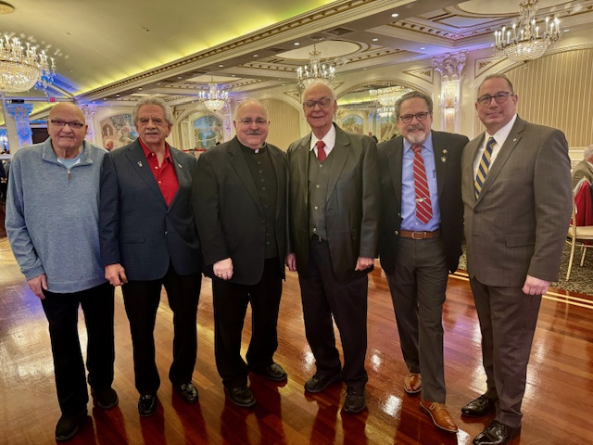
L- Pres. Bob Valentino, Msgr. Romano, 2nd VP Ronnie DiMaio
R- Frank Crisa, Bob Valentino. Msgr. Romano, Ronnie DiMaio, Tony Lomanto, Paul DiGiacomo

Slide 5
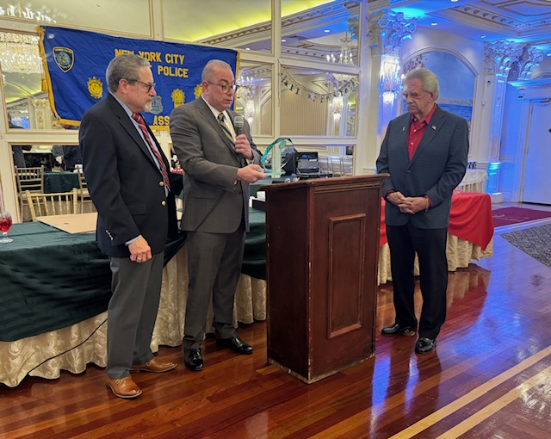
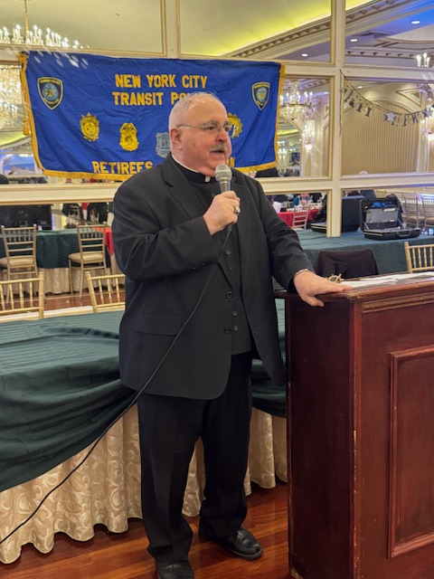
L - Association Chaplain Msgr. Romano giving a blessing to all our members.
R- DEA President Paul DiGiacomo and Association President Bob Valentino presenting award to Treasurer Tony Lomanto

Slide 6
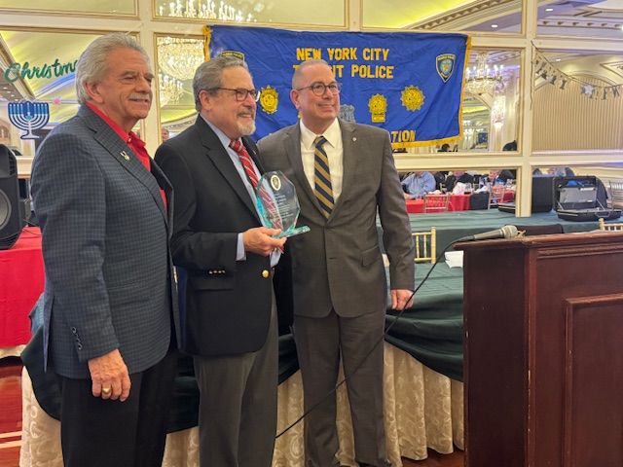
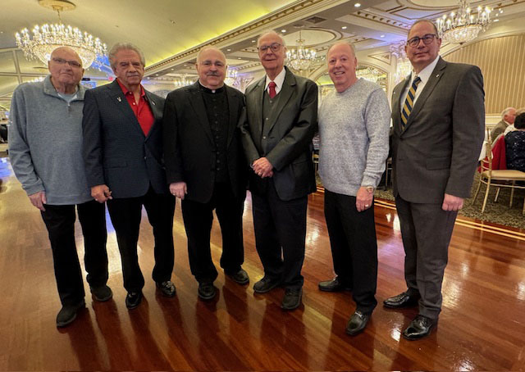
L – Tony Lomanto receiving the Award plaque
R- Frank Crisa, Bob Valentino, Msgr. Romano, Ron DiMaio, Fred Ametrano, Paul DiGiacomo

Slide 7
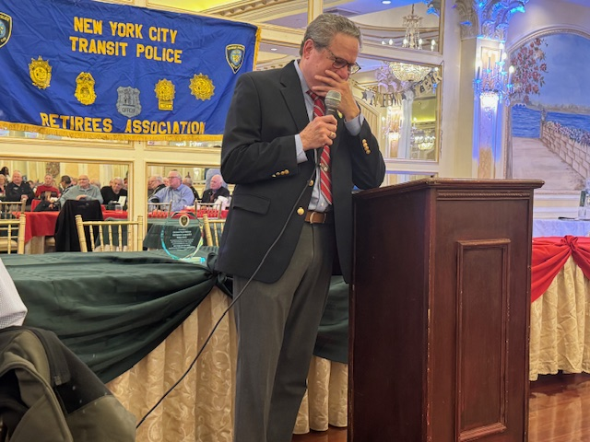
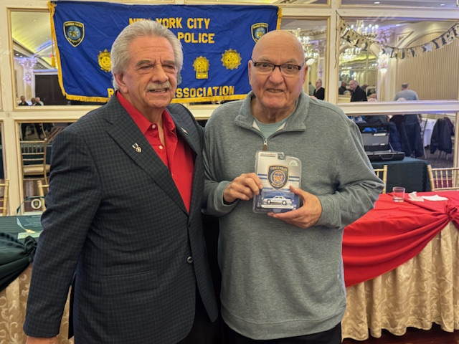
L- Tony trying to maintain his composure in thanking everyone.
R- President Bob Valentino presenting an award to our Editor, Frank Crisa, for his outstanding work with our “Beyond the Line” newsletter and Keeping the “Transit Spirit” alive

Slide 8
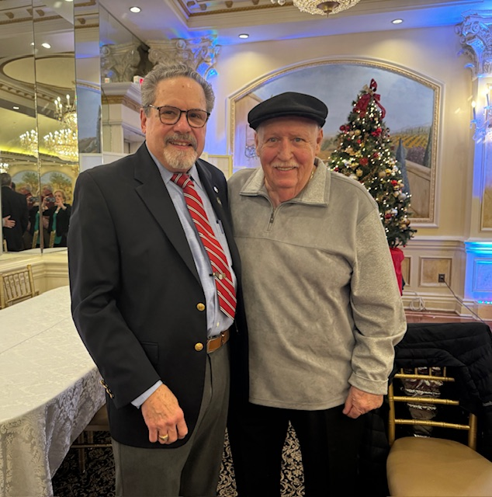
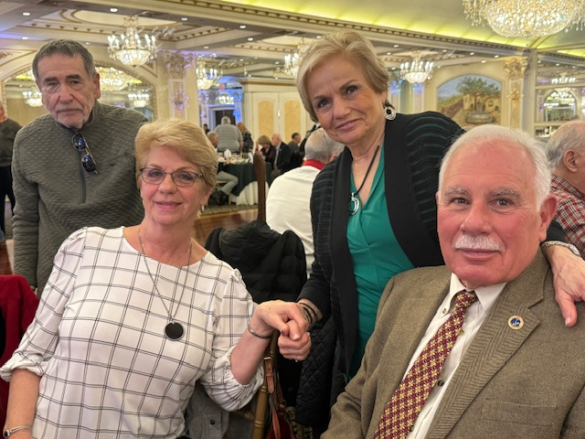
L- Tony Lomanto & Mike Lanning
R- Jeff McGunnigle, Peggy Lipira, my partner, Emily Sicoli, Mark Lipira

Slide 9
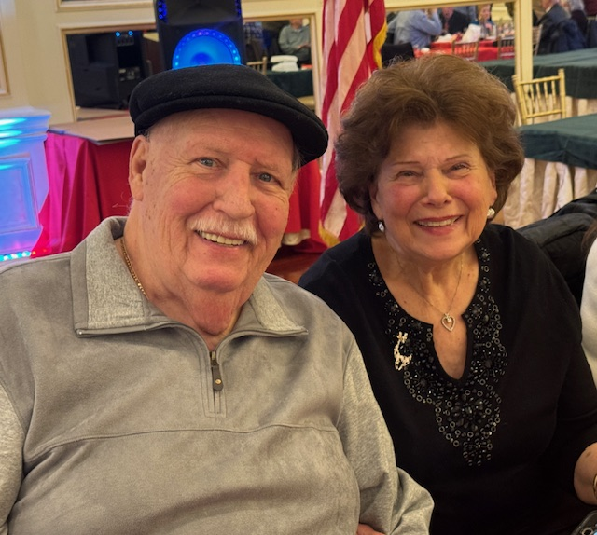
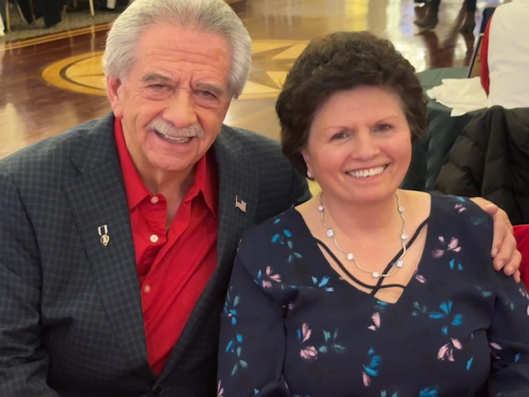
Mike & Doris Lanning Bob & Jessica Valentino

Slide 10
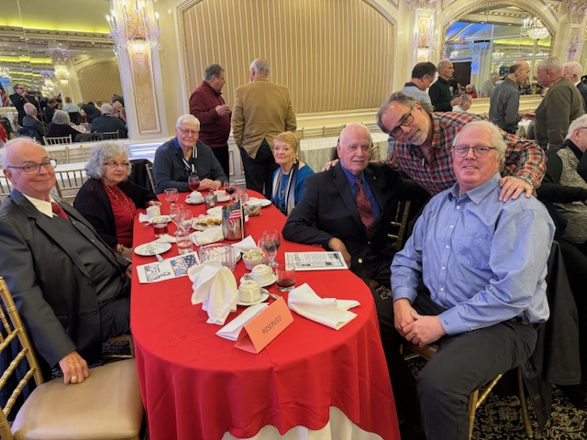
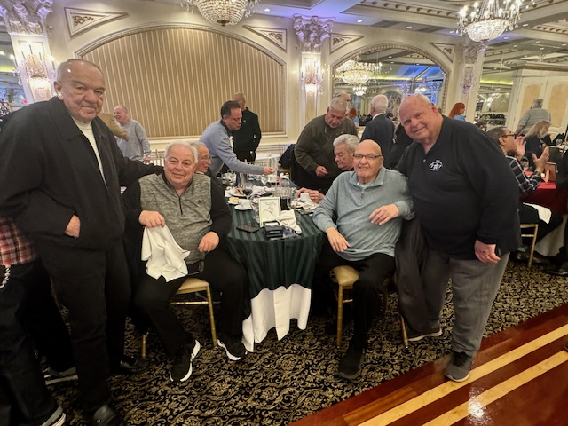
L- Ron & Rita DiMaio, Bob & Fran Forrester, Chet Levey, Steve Mona, Jay Finn
R- Frank Gandini, Al Ciprello, Joe DiDonato, Luke Scarangello, Frank Crisa, Hank Melchiona

Slide 11
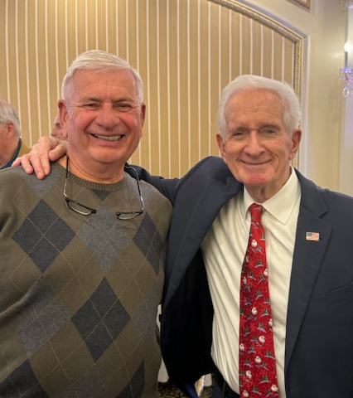
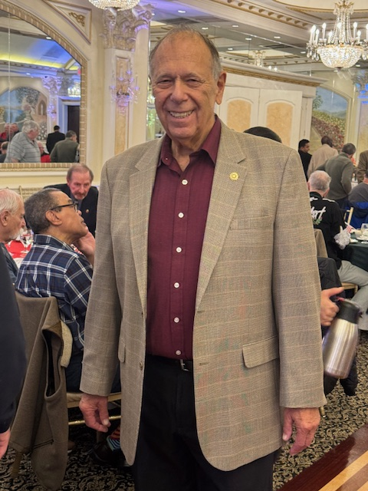
Ken Chiulli Joe Veneziano, John Kavanagh

Slide 12
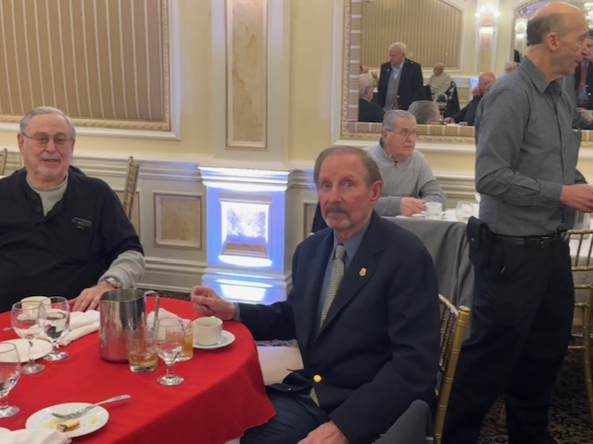
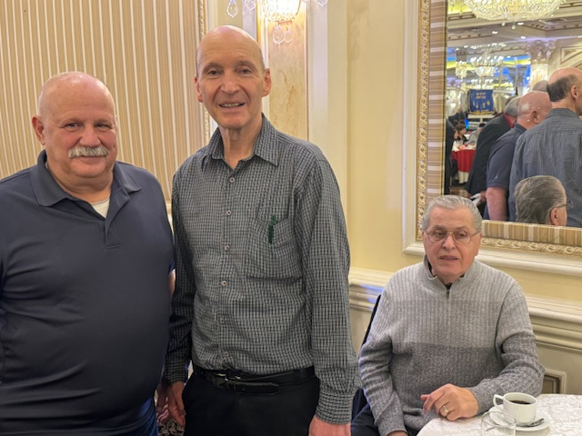
L - Les Isaacson, Stan Reiter, Frank Prevete, Jack Almalech
R - Frank Muzio, Jack Almalech, Frank Prevete

Slide 13
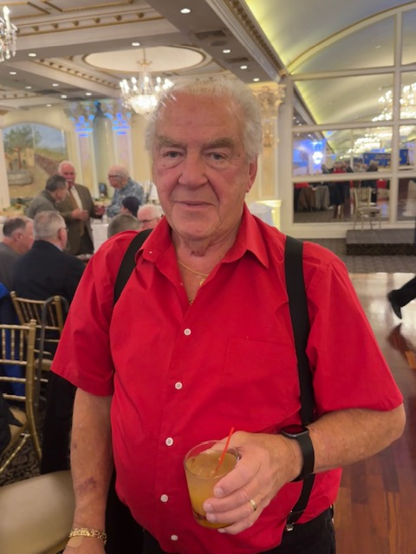
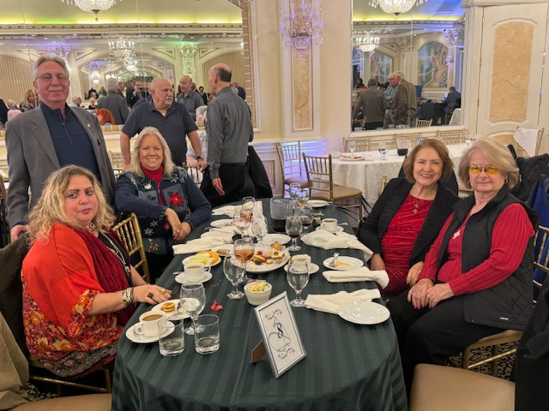
L - John Fay
R - Debbie Banahan, Bob Lentol, Roxanne Mahler , ?, Karen Regan

Slide 14
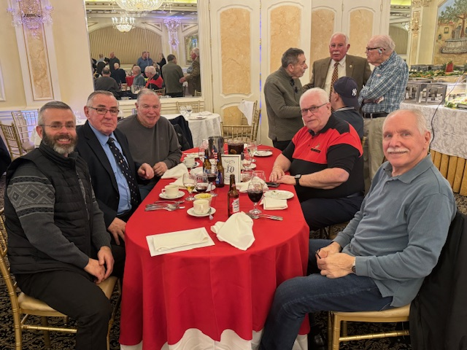
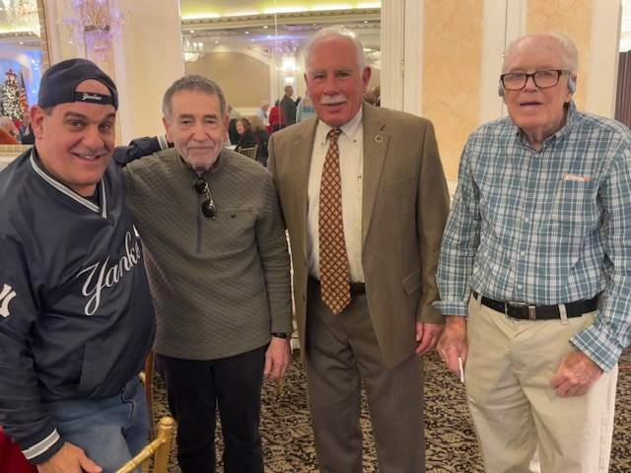
L- Scott & John Reeves, John Burgois, Jim Kirk, Peter Caso
R- Bob Papa, Jeff McGunnigle, Mark Lipira, Tommy Strong

Slide 15
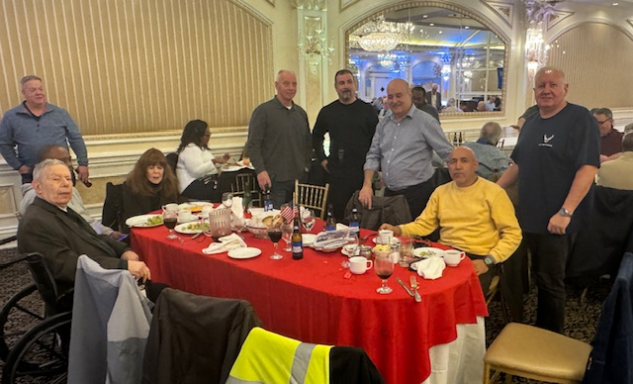
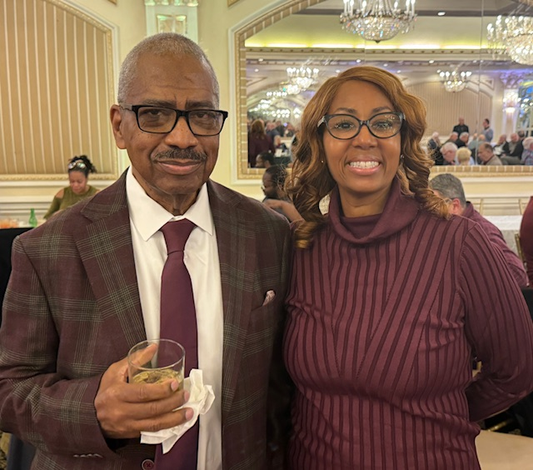
Dave Kolman and others (?) Lothel Crawford, Michelle Kemp

Slide 16
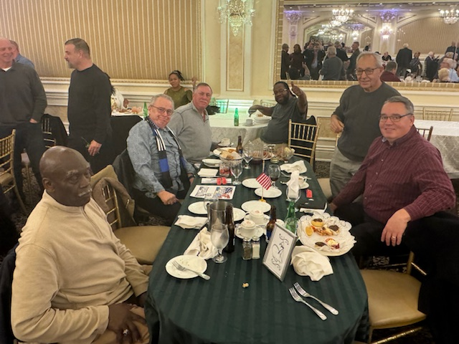
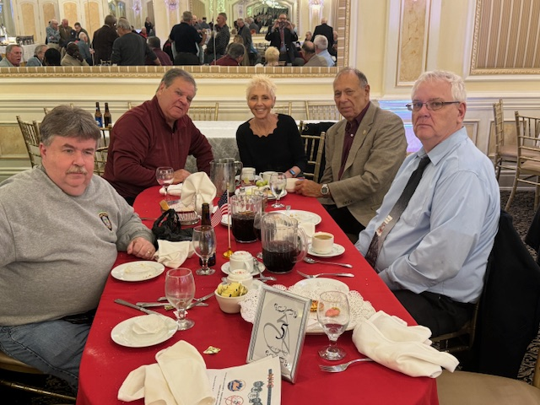
L- ?, Mike Lavelle, George Colgan, Bernard Smiley, Arnie Fisher, Kevin Byrnes
R- John Tully, Deo Fasolino, Maria & Ken Chiulli, Tom Dowd

Slide 17
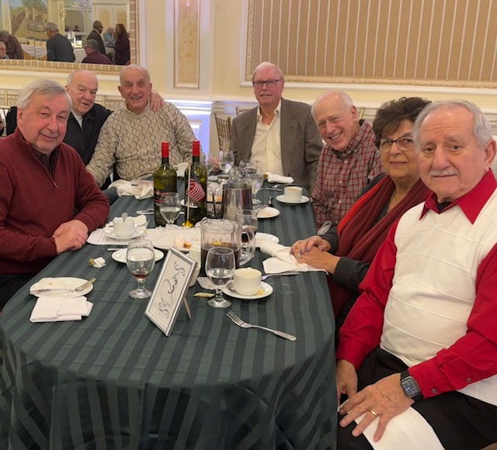
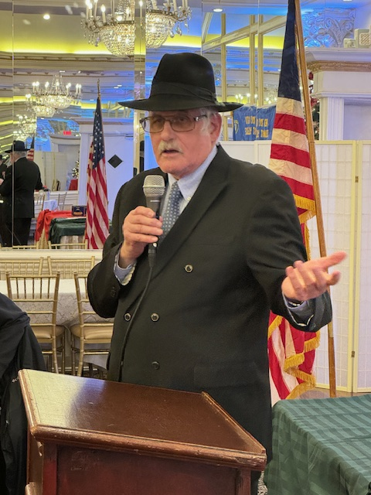
Joe Asti, Frank Gandini, Sam Sapienza, Bob Kent,
Jerry Castro, Carmella and Al Pelliccia
Association Chaplain Rabbi Berkowitz

Slide 18
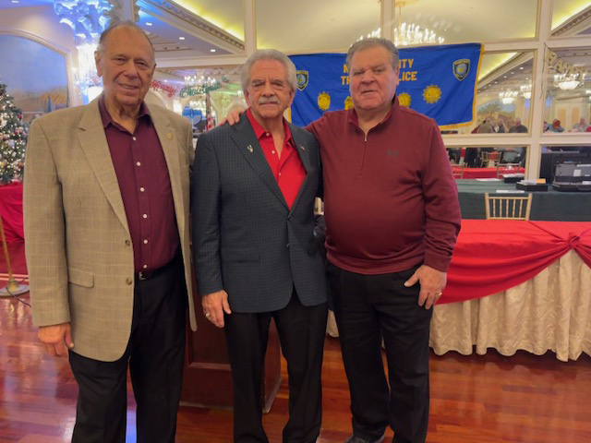
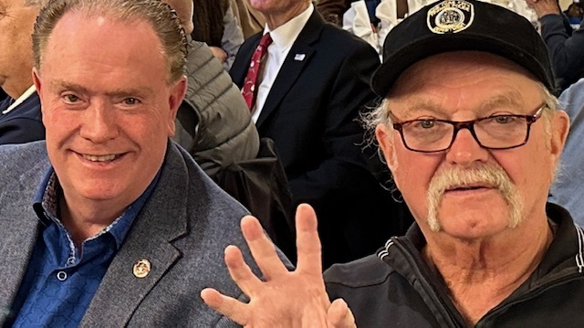

Ken Chiulli, President Valentino, 1st VP Deo Fasolino
Exec. Sec’ty. Tom Greer & Fin. Sec’ty. Greg Stripp at the door

