Slide 1

Christmas Holiday Party 2025
December 4, 2025
Verdi’s of Westbury

Slide 2
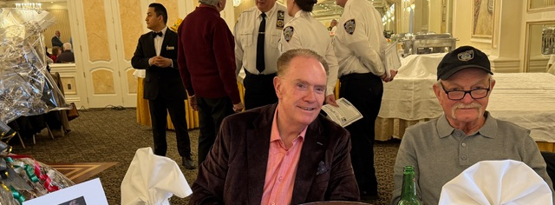
Executive Secretary Tom Greer and Financial Secretary Greg Stripp warmly greeting the members at the door and ready with the raffle tickets.

Slide 3
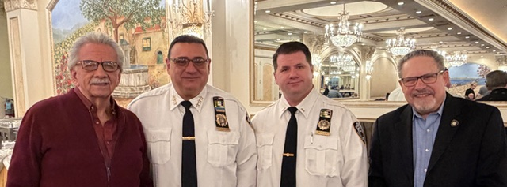
President Bob Valentino with Transit Bureau Chief Joseph Gulotta,
Capt. Scaly, and Treasurer Tony Lomanto

Slide 4
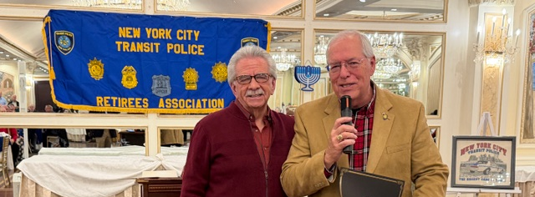
President Valentino bestowing Regular Membership to
Al O’Leary, former spokesperson for the NYC Transit Police Department.

Slide 5
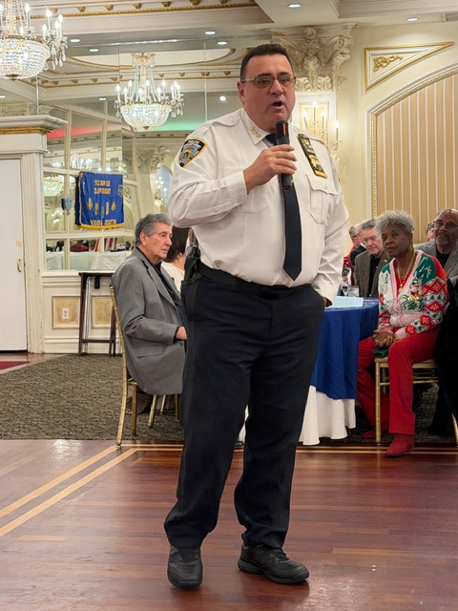
Transit Bureau Chief Gulotta speaking to the group and praising the work the original Transit Police officers performed under not so great conditions.

Slide 6
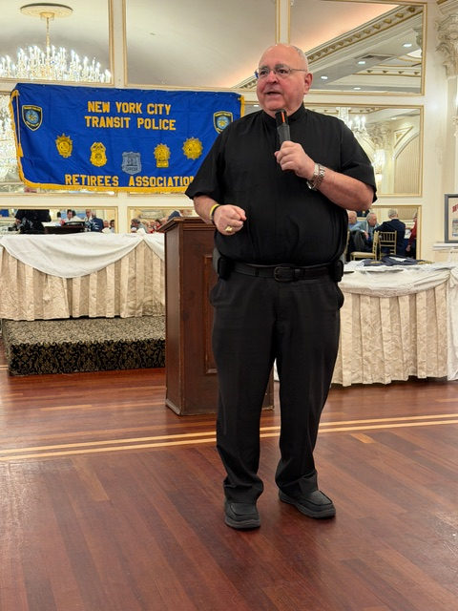
Msgr. Romano speaking to and blessing the group

Slide 7
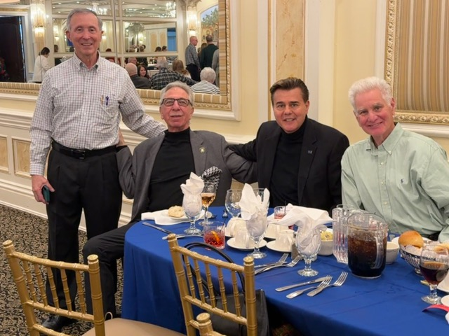
L-R
Tony Piazza, Bob Lentol, Jim Veneziano, Mike Banahan chatting and eating.

Slide 8
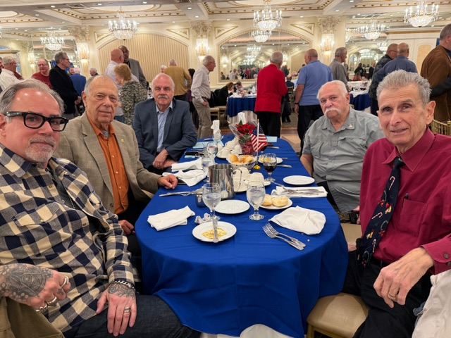
L-R Steve Mona, Ken Chiulli,
Ihor Likiw,
John Giangrasso, John Rini

Slide 9
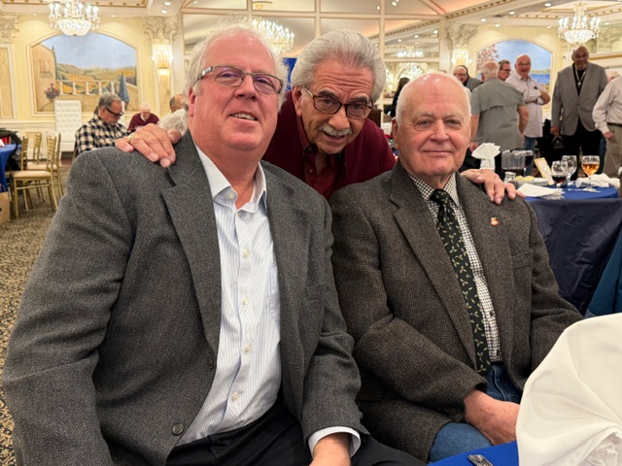
L-R
Jay Finn, Bob Valentino, and Chet Levey reliving the “Old days in Transit.”

Slide 10
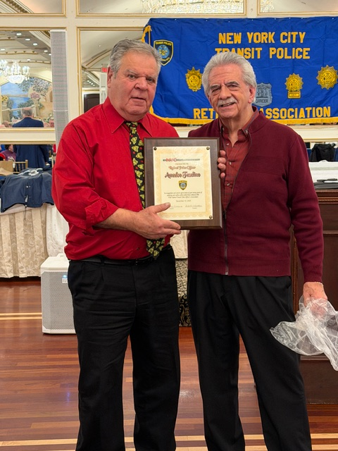
1st VP Deo Fasolino receiving his Achievement Award from Pres. Valentino

Slide 11
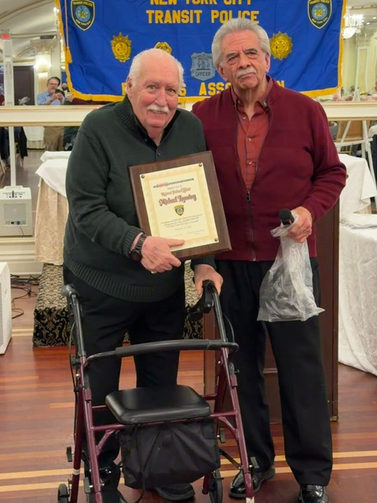
Sgt-at-Arms Mike Lanning receiving his Achievement Award from Pres. Valentino

Slide 12
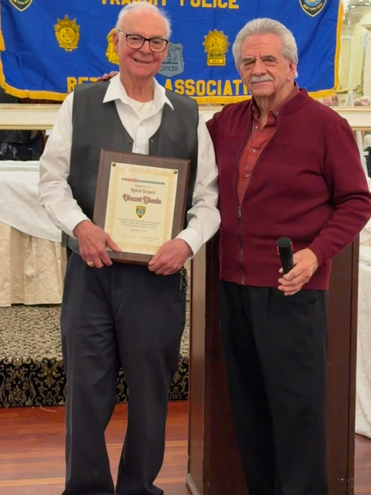
2nd VP Vinny DiMaio receiving his Achievement Award from Pres. Valentino

Slide 13
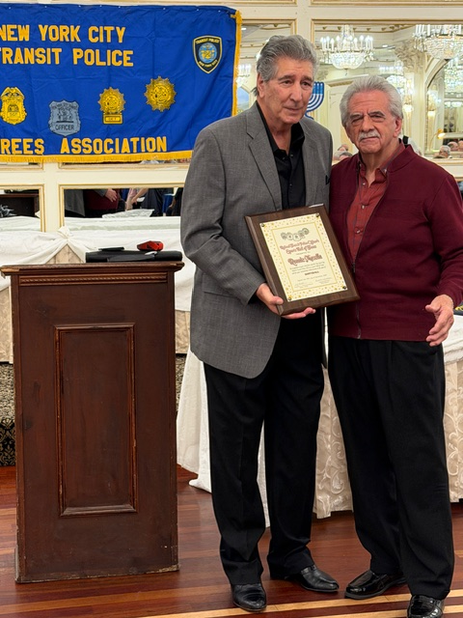
Ret. Lt. Ron Masella receiving his Transit Retirees Sports Hall of Fame Award for Softball from Pres. Valentino

Slide 14
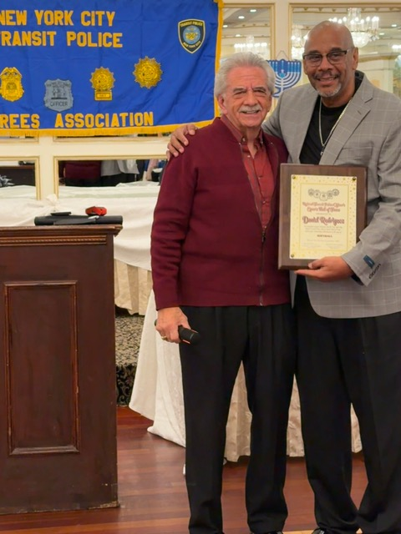
Ret. P.O. Daniel Rodriguez receiving his Transit Retirees Sports Hall of Fame Award for Softball from Pres. Valentino

Slide 15
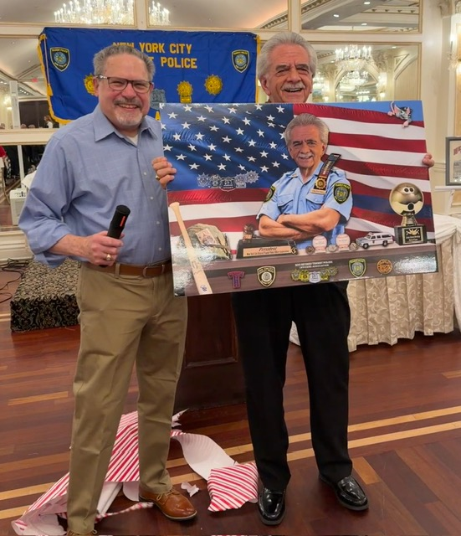
Tony Lomanto with President Valentino who was totally surprised with a caricature poster designed by our own member, Ret. P.O. Ronnie Morales

Slide 16
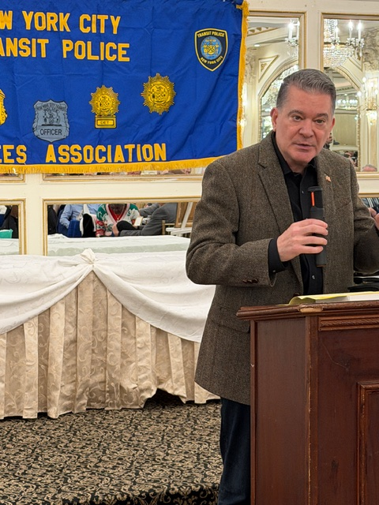
Guest speaker from FOX News, commentator Ret. NYPD Insp. Paul Mauro, son of the late Ret. TP Sgt. Mario Mauro speaking to the group with many stories.

Slide 17
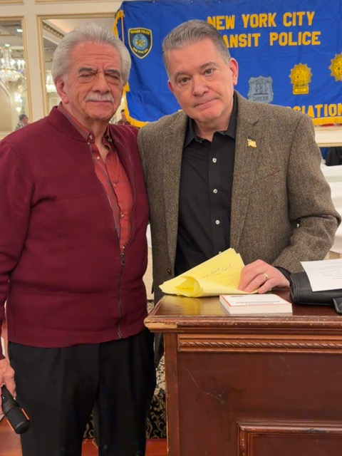
President Valentino with Paul Mauro

Slide 18
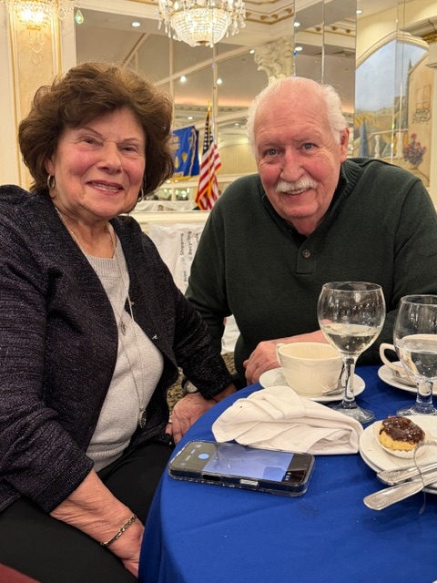
Doris and Mike Lanning enjoying the party

Slide 19
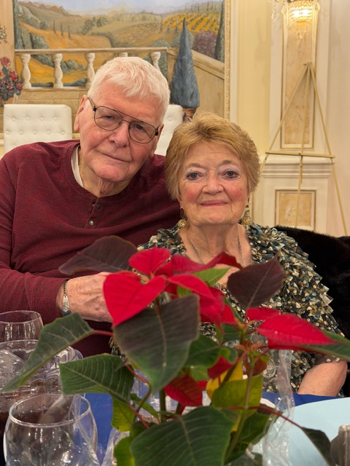
Bobby and Fran Forrester having a great time at the party.

Slide 20
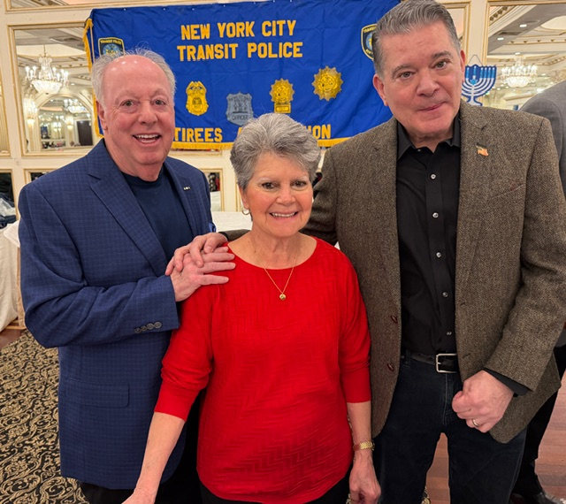
Fred and Maria Ametrano with Paul Mauro

Slide 21
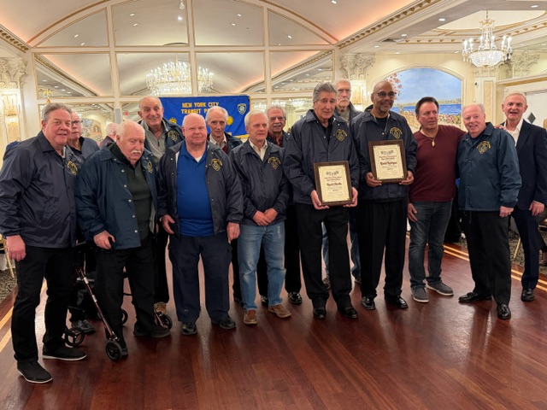
The Transit Retirees Sports Hall of Fame members at the party

Slide 22
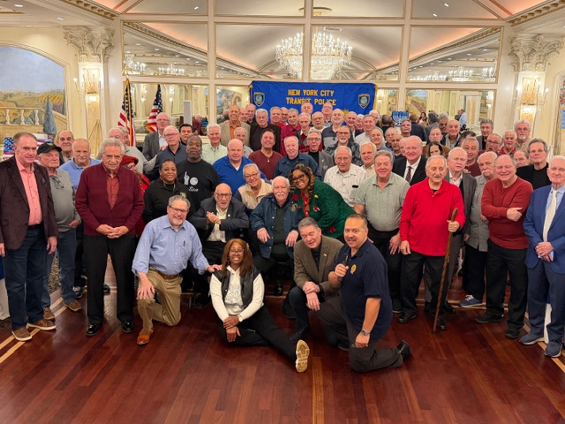
Our many Association members who came to celebrate the Christmas Holiday party at Verdi’s.
Thank you all for being there to join us.

