Slide 1
Brendan ‘Joe’ McGarry Internment Ceremony at Pinelawn National Cemetery
July 6, 2022

Slide 2

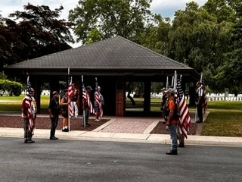

Slide 3
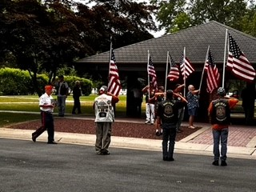
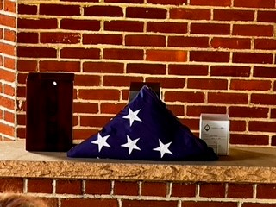

Slide 4
